Slide 1

REDUCE
MANUAL TESTING
ONE WEIRD TRICK
WITH THIS
FIND OUT HOW

Slide 2








JOHNREESE
It really bothers me that this space is empty.
reesespieces.io

Slide 3
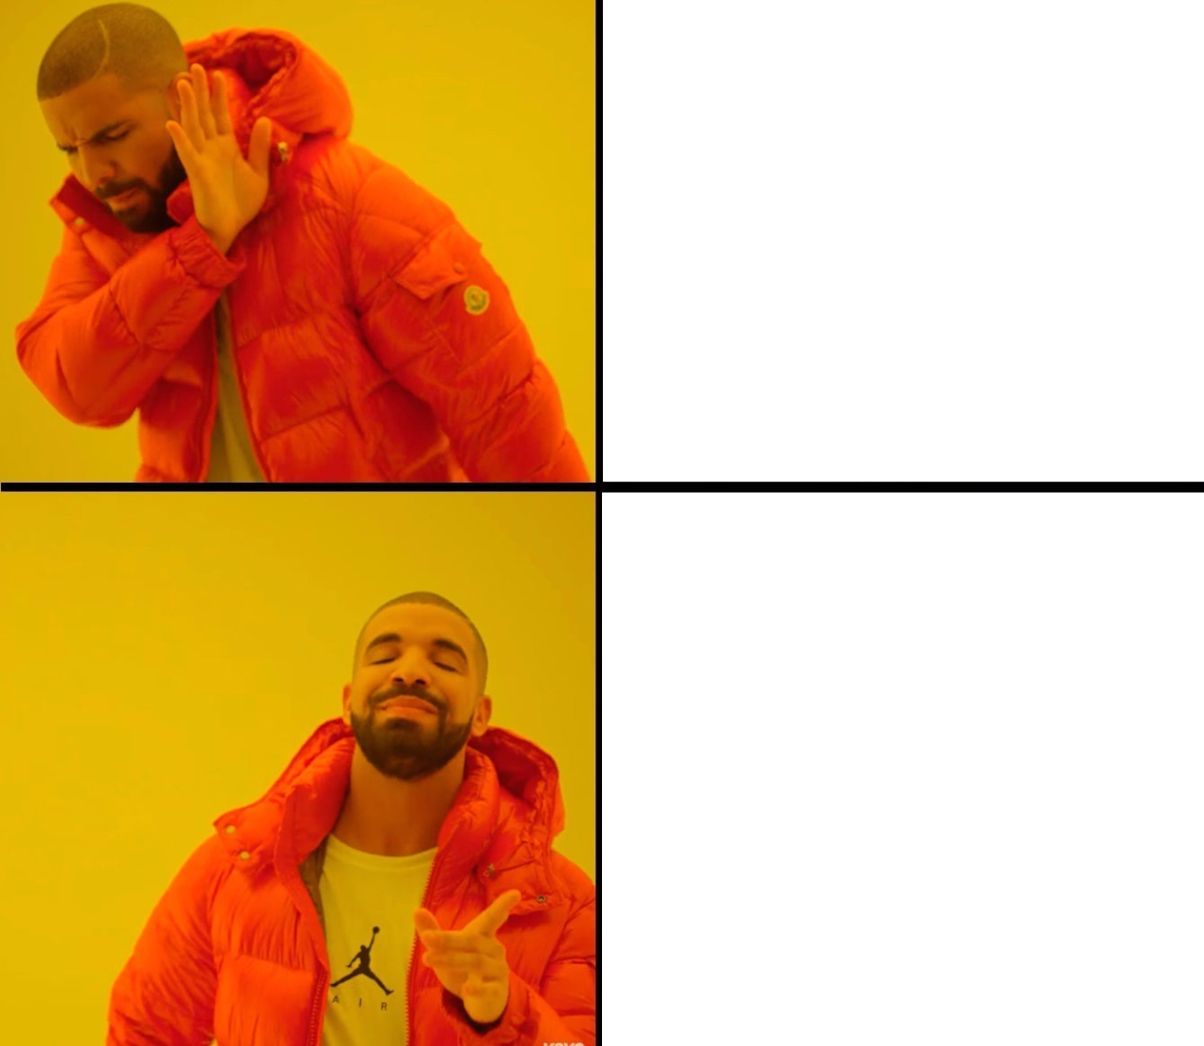
MANUAL TESTING
UNIT TESTING
Notes:
Not only does it reduce manual testing
Sticks with you whichever environment youre in
Its not like learning..

Slide 4
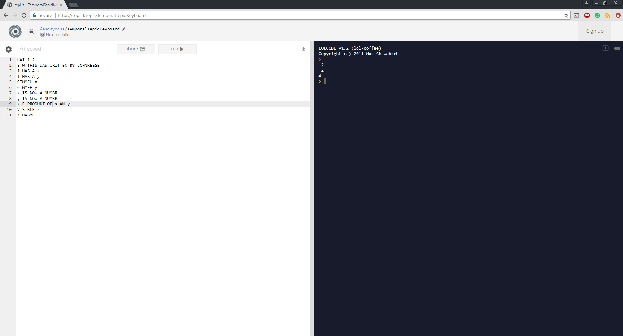


Slide 5

UNIT TESTING
TEST
DRIVEN
DEVELOPMENT

Slide 6

testing
types of

Slide 7



unit
an isolated unit of work functions as expected.
OK.. THERE’S A LOT MORE
integration
anything that can’t be described as a unit test.

Slide 8
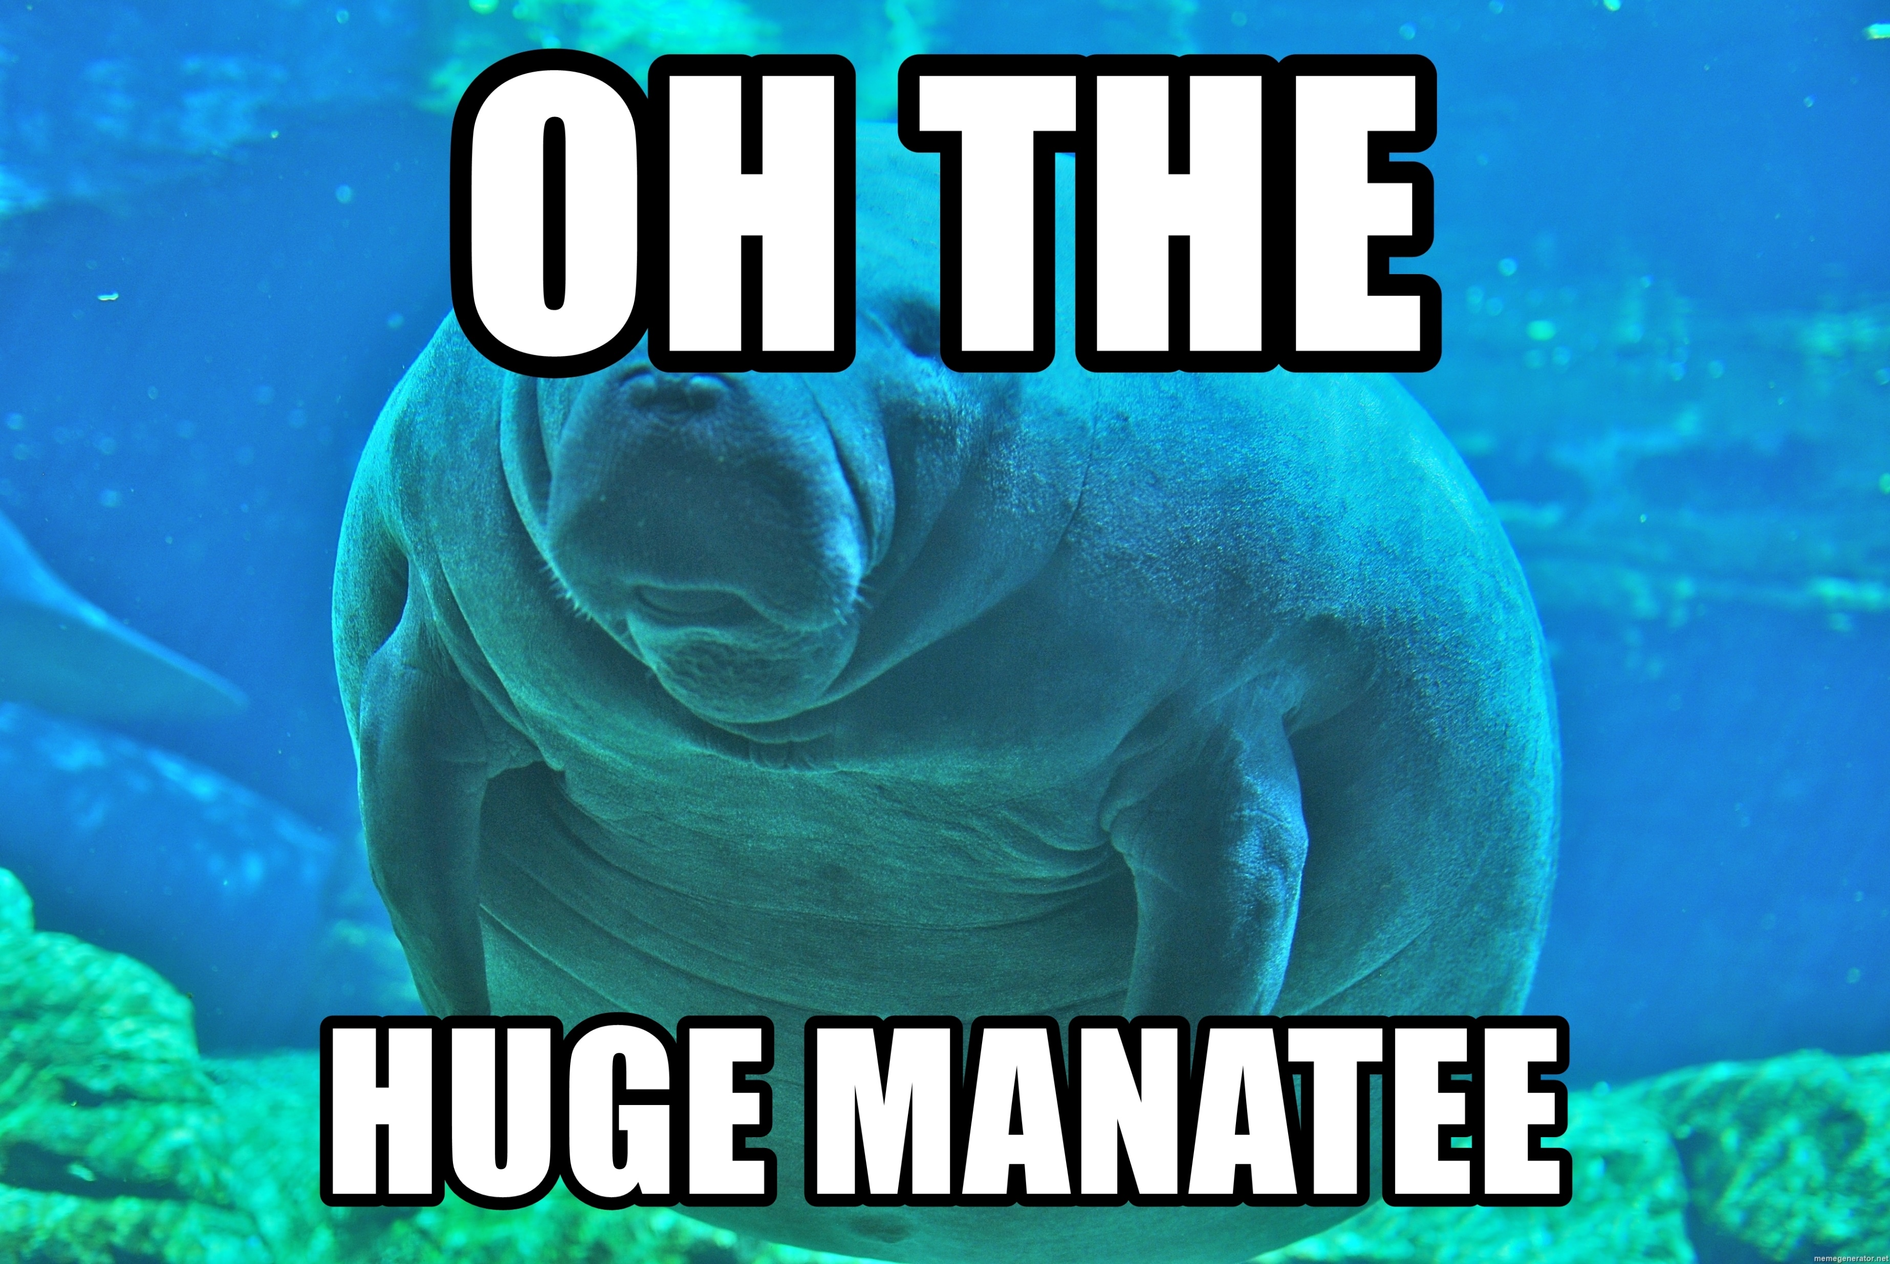

Slide 9
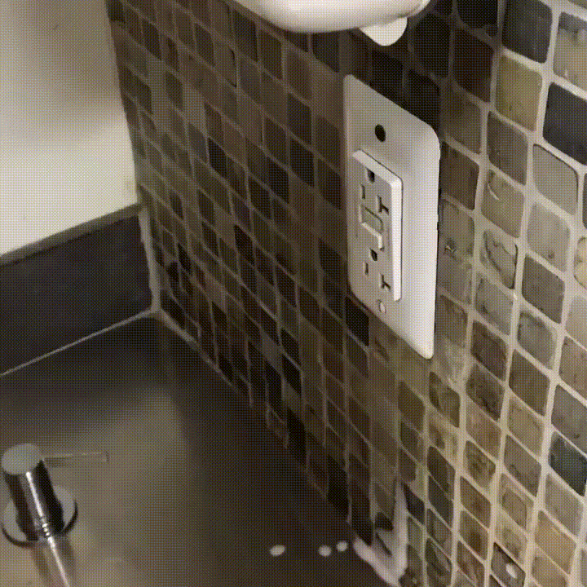
UNIT
VS
INTEGRATION
TESTING

Slide 10
?
what
makes
a good
unit test

Slide 11


Slide 12
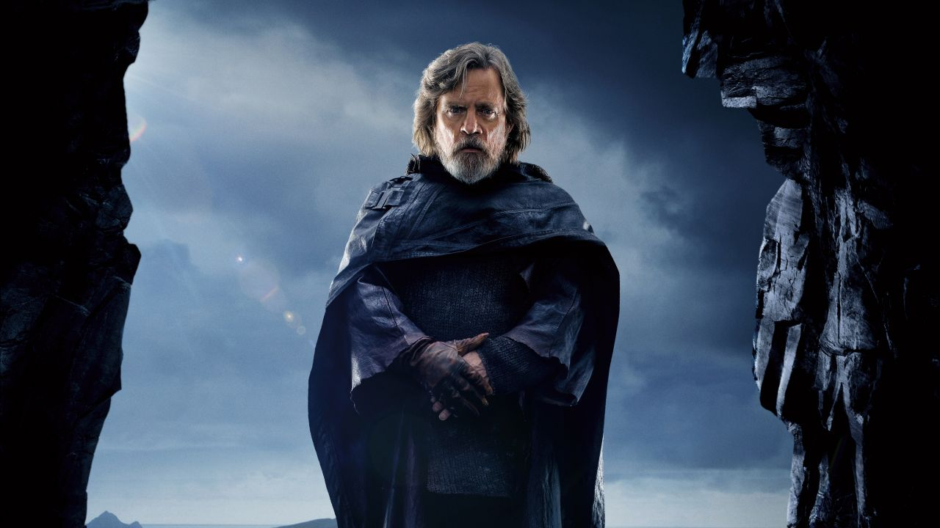
isolated

Slide 13


REPEATABLE
that’s some
pretty nice hair

Slide 14
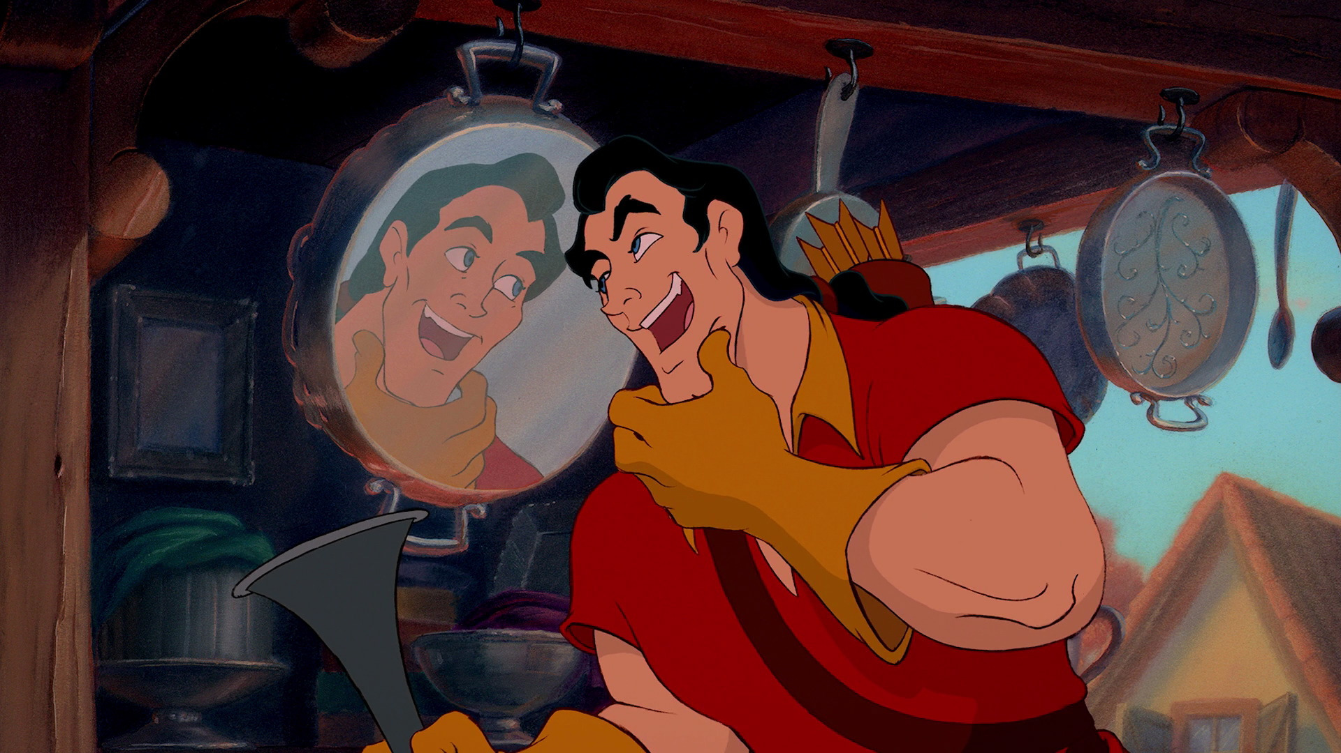
self
checking

Slide 15

timely

Slide 16

7 HOURS LATER

Slide 17
unit
WHY
testing
are we talking about this?

Slide 18

less time performing manual tests
Notes:
We do manual tests now because its all we got, necessary evil

Slide 19

protection against regression

Slide 20

executable documentation

Slide 21

less coupled design

Slide 22
NO
SILVER
BULLET
Mythical Man-Month, “No Silver Bullet”
Essence and Accident In Software Engineering, Part 16

Slide 23

slows initial development velocity

Slide 24

bad tests can diminish value

Slide 25

difficult with legacy code

Slide 26
?
what
does
a unit test
look like

Slide 27
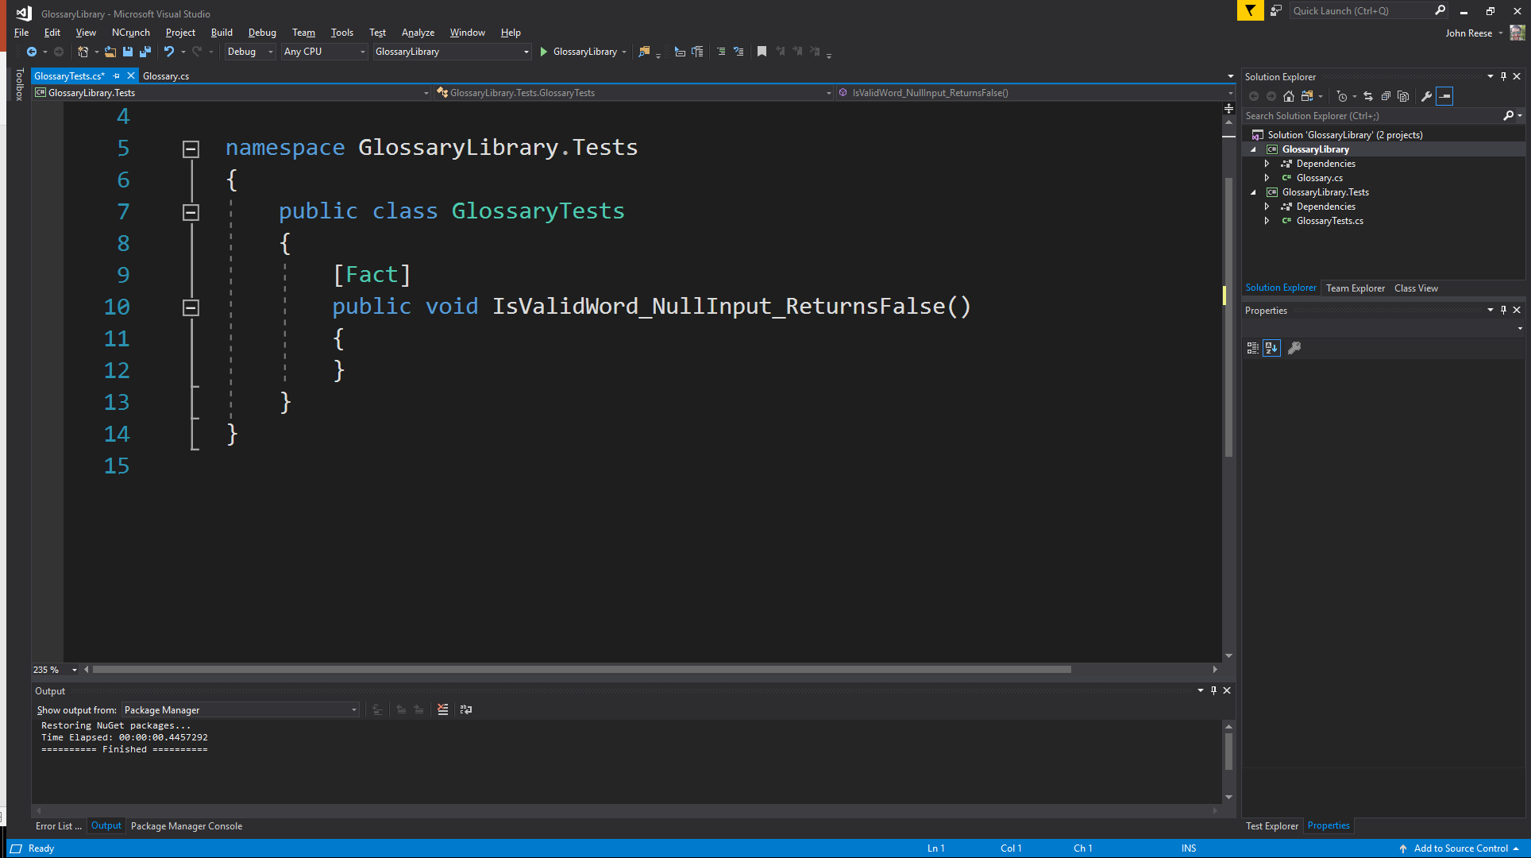



expected behavior
scenario
unit of work

Slide 28
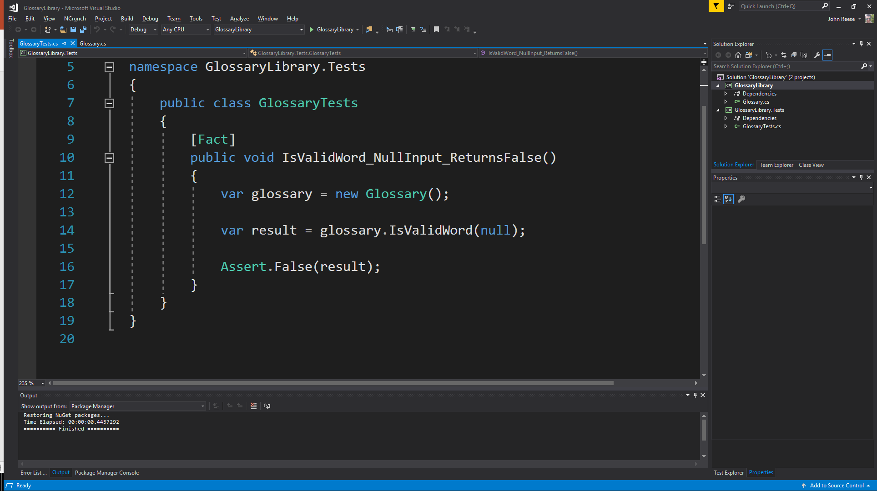
arrange
act
assert

Slide 29

THE ACT OF WRITING A UNIT TEST IS MORE AN ACT OF DESIGN THAN VERIFICATION.
UNCLE BOB

Slide 30
INSIDE
OUTSIDE
VS
OUT
IN
DESIGN

Slide 31

test
driven
development

Slide 32

create a unit test that fails

Slide 33

make the test pass

Slide 34

clean up the mess you just made

Slide 35

DON’T WORRY
IF IT’S NOT
PERFECT

Slide 36

AS THE TESTS GET MORE SPECIFIC, THE CODE GETS MORE GENERIC.
UNCLE BOB

Slide 37
public class EightBall
{
public string GetResponse(int randomNumber)
{
if(randomNumber == 1)
{
return “It is decidedly so”;
}
if(randomNumber == 2)
{
return “Reply hazy try again”;
}
if(randomNumber == 3)
{
return “My sources say no”;
}
}
}
public class EightBall
{
public string GetResponse(int randomNumber)
{
var responses = new Dictionary<int,string>
{
{ 1, “It is decidedly so” },
{ 2, “Reply hazy try again” },
{ 3, “My sources say no” }
};
return responses[randomNumber];
}

Slide 38

TRANSFORMATION
PRIORITY
PREMISE

Slide 39
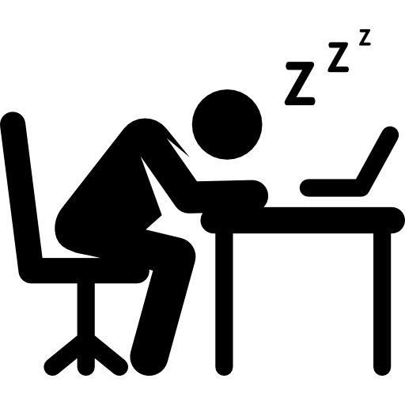
({ }–>nil) no code at all->code that employs nil
(nil->constant)
(constant->constant+) a simple constant to a more complex constant
(constant->scalar) replacing a constant with a variable or an argument
(statement->statements) adding more unconditional statements.
(unconditional->if) splitting the execution path
(scalar->array)
(array->container)
(statement->recursion)
(if->while)
(expression->function) replacing an expression with a function or algorithm
(variable->assignment) replacing the value of a variable.
https://8thlight.com/blog/uncle-bob/2013/05/27/TheTransformationPriorityPremise.html

Slide 40
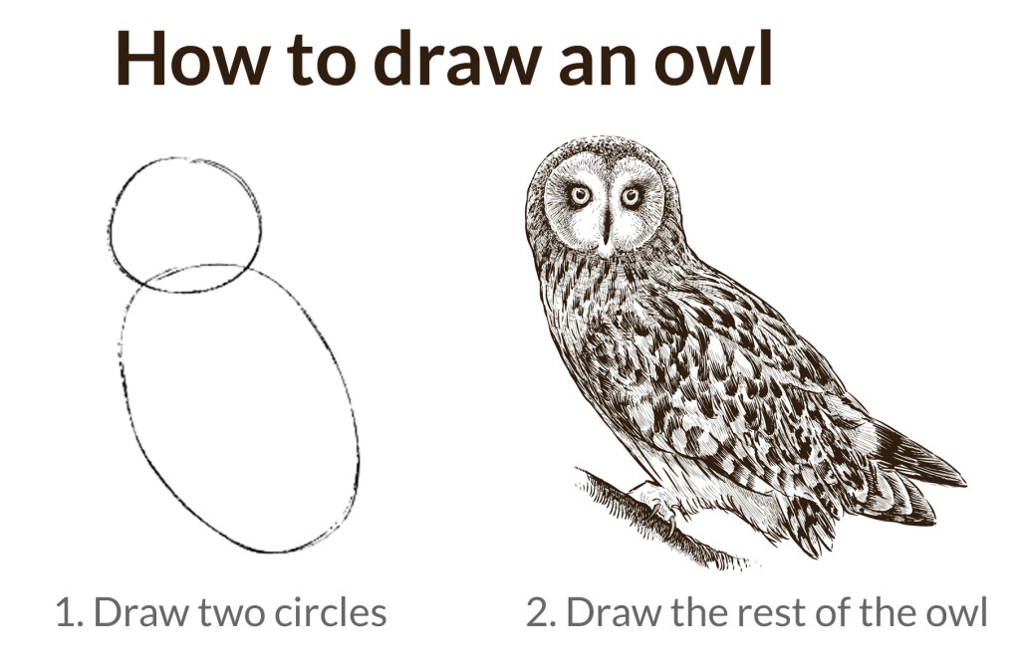

Slide 41
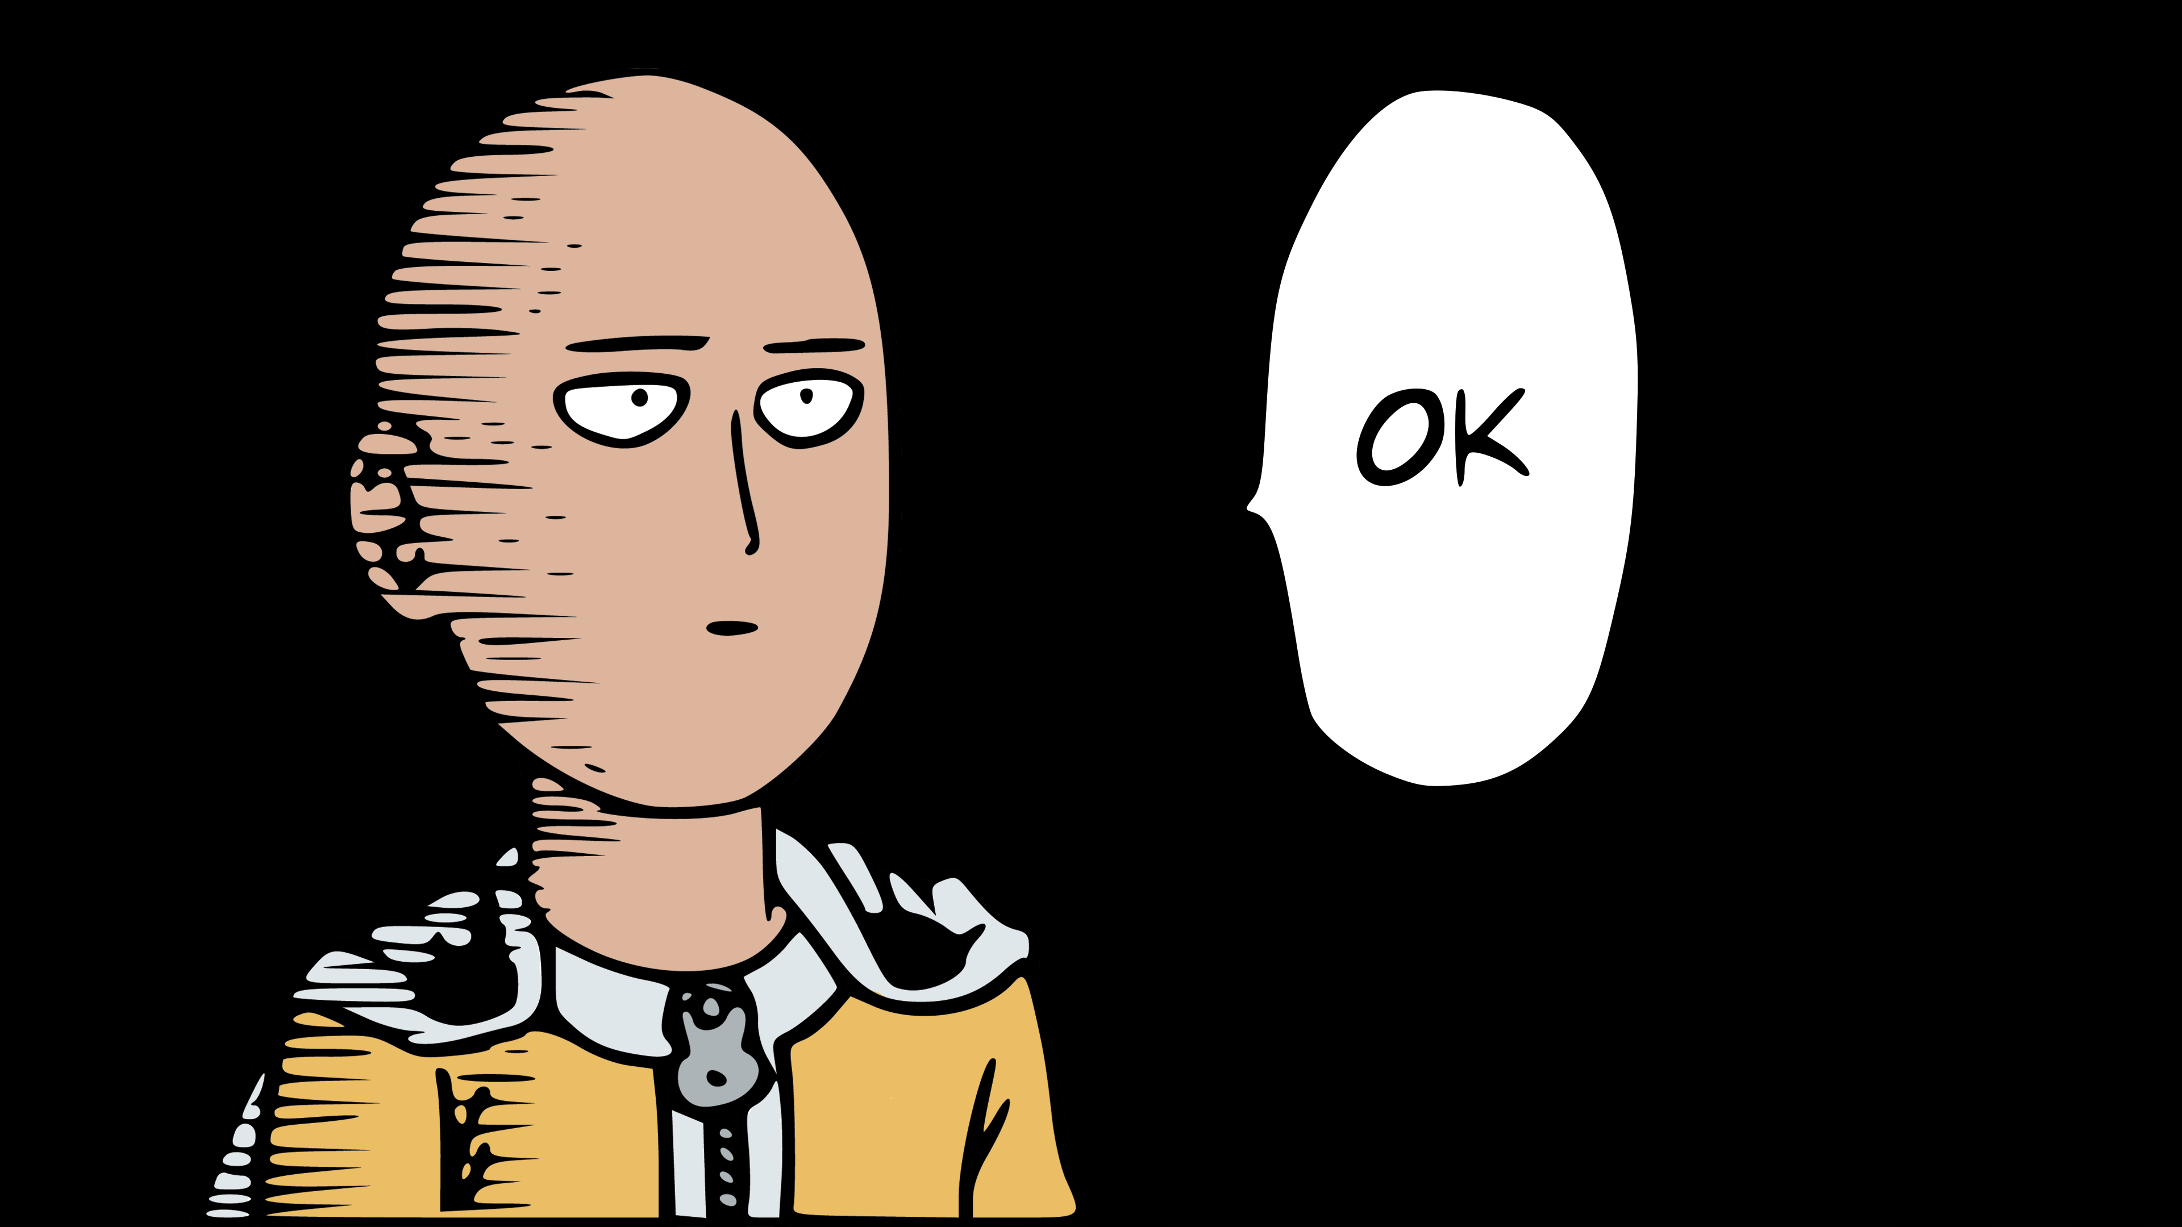
OK

Slide 42
COOL

Slide 43

NEW IS GLUE
STEVE SMITH

Slide 44
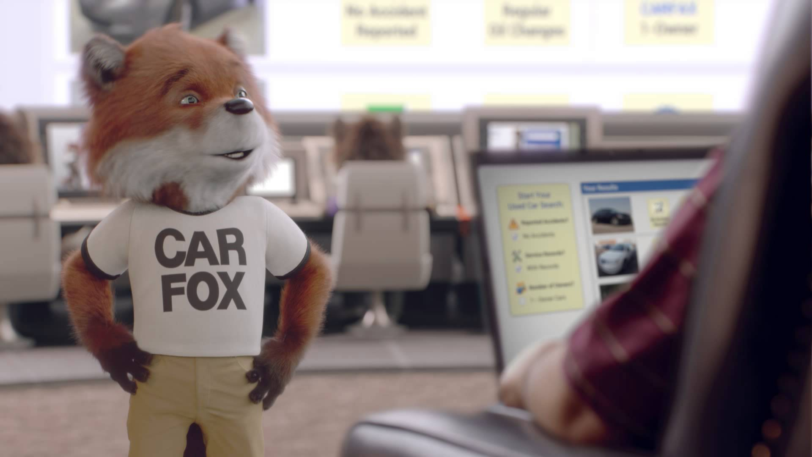
show me something
REAL

Slide 45
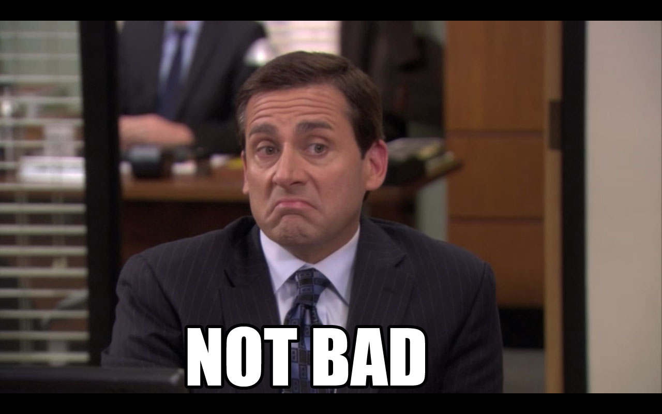

Slide 46

tl;dr.. unit testing is awesome

Slide 47
exercism.io

Slide 48

It’s over

